Slide 1
物聯網技術與應用 Internet of Things: Technologies and Applications
Tutorial for LAB1:
Introduction to Arduino NANO and IDE
教育部5G行動寬頻人才培育計畫
Notes:
Hello, well come to Lab 1 of Internet of Things: Technologies and Applications course.
Introduction to Arduino NANO and IDE.
This course is sponsored by Ministry of Education 5th Generation Mobile Broadband Talent Cultivation Program.

Slide 2
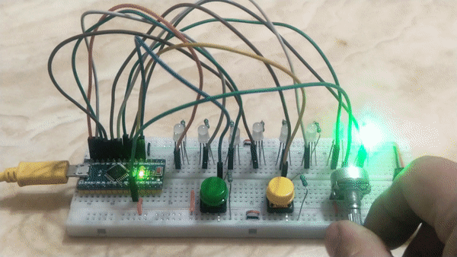
Objective
Preparation Work
Install USB driver of Arduino Nano
Download and install Arduino IDE (Integrated Development Environment)
Wiring up a new bread board
Configure GPIO pins
Control LED
Detect Button Switch
Read Voltage Value From Variable Resistor
Notes:
The objective of this lab is to finish Preparation Work, including.
Install USB driver of Arduino Nano.
Download and install Arduino IDE (Integrated Development Environment).
Wiring up a new bread board.
Configure GPIO pins.
Control LED.
Detect Button Switch.
Read Voltage Value From Variable Resistor.
Now, please follow the instruction of the slides step by step.

Slide 3
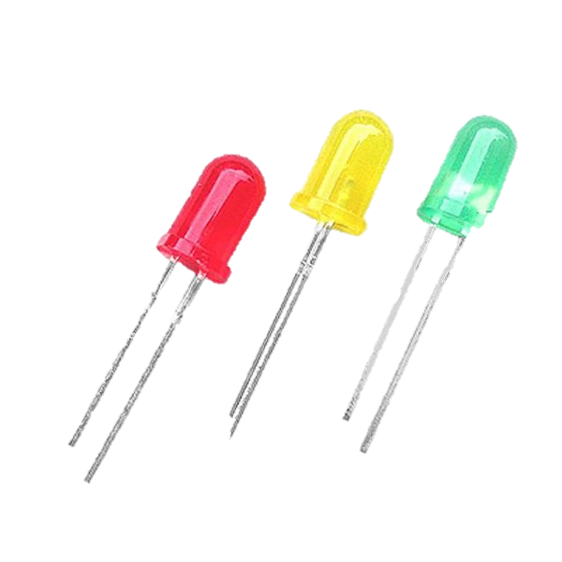
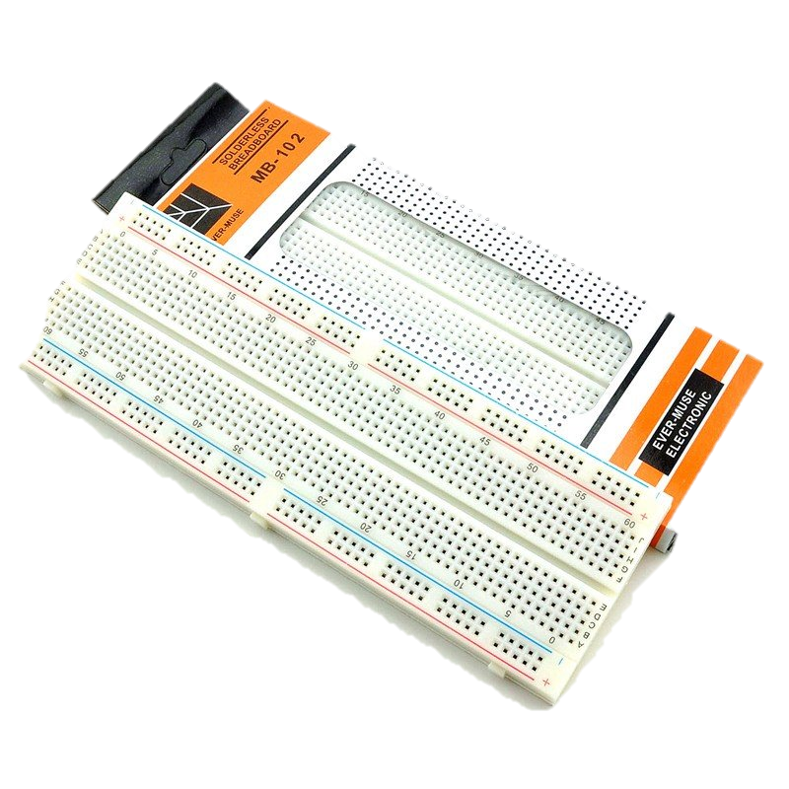
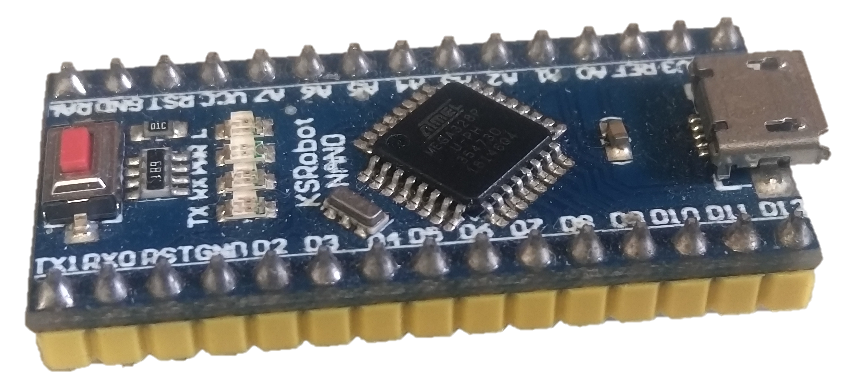
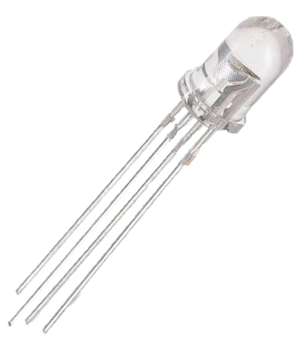
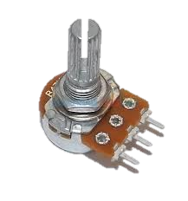
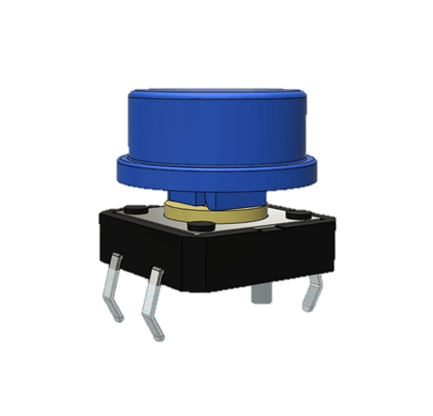
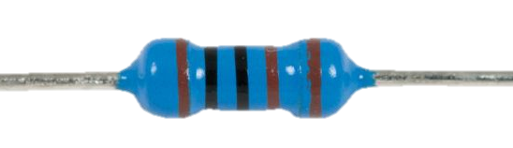
Main Components
Arduino NANO
LED (single color, tri-color)
BreadBoard
Resistor
Button Switch
Variable Resistor
Notes:
These are main components we may utilize in this lab, including breadboard, Arduino NANO, LED, Button Switch, 1 k ohm resistor, and a variable resistor.

Slide 4
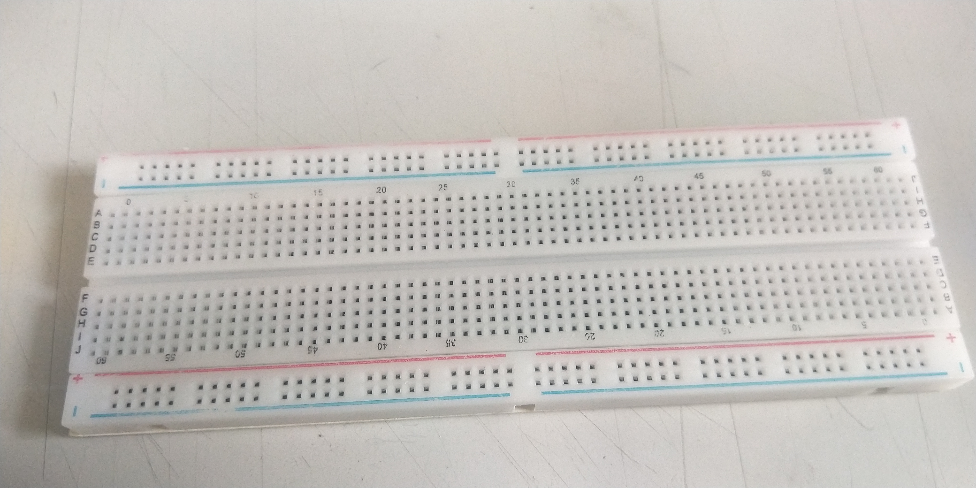
Preparation Work
Install USB driver of Arduino Nano
Download and install Arduino IDE (Integrated Development Environment)
Wiring up a new breadboard
Please refer to Appendix and
reference links at the bottom of each page
These holes by the blue and red lines
are for power supply for the devices.
But for the convenience of variety settings,
they are initially isolated.
Notes:
First, we need to download and Install USB driver of Arduino Nano and Arduino I.D.E. as known as Integrated Development Environment.
To finish this part of work, Please refer to Appendix and reference links at the bottom of each page.
After the driver and the I.D.E is ready, we also need to wire up a new breadboard.
In this figure, we can see holes by the blue and red lines for power supply for the devices.
For the convenience of variety settings, they are initially isolated by factory default.
We need to wire them up.

Slide 5
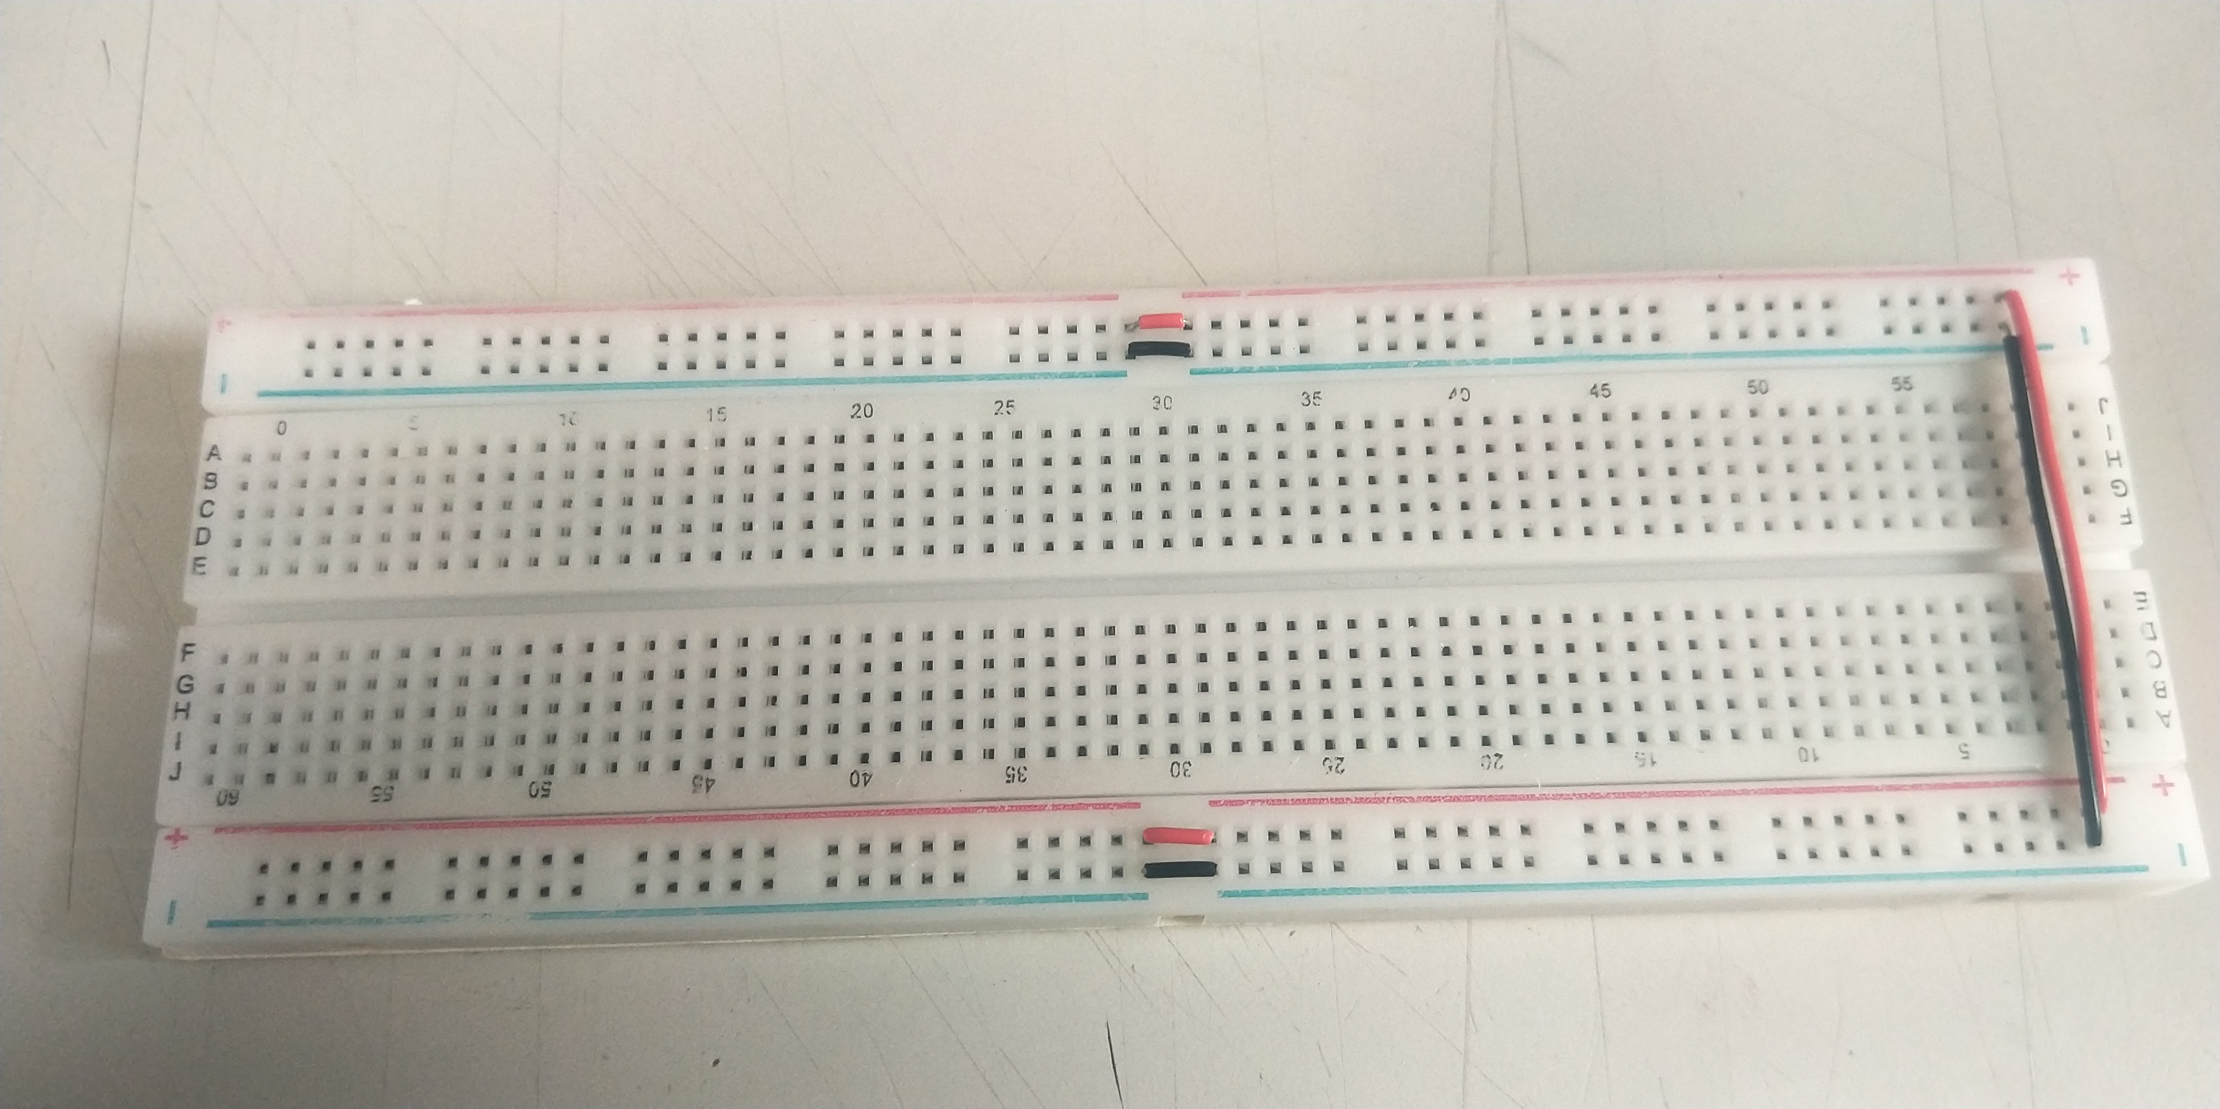
Wiring up a new bread board
According to our purpose, we only need single voltage power source (5V), so we first wire all these isolated holes for easy connecting.
Red lines and wires stand for Vcc (+5V), blue lines and black wires stand for GND (Ground).
Notes:
According to our purpose, we only need single voltage power source (5V), so we first wire all these isolated holes for easy connecting.
Red lines and wires stand for Vcc (+5V), blue lines and black wires stand for GND (Ground).

Slide 6
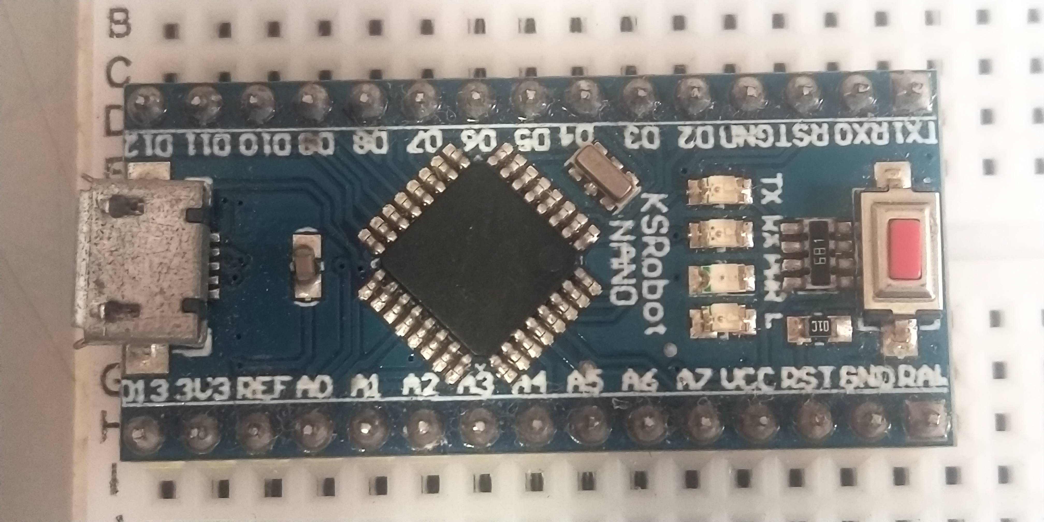
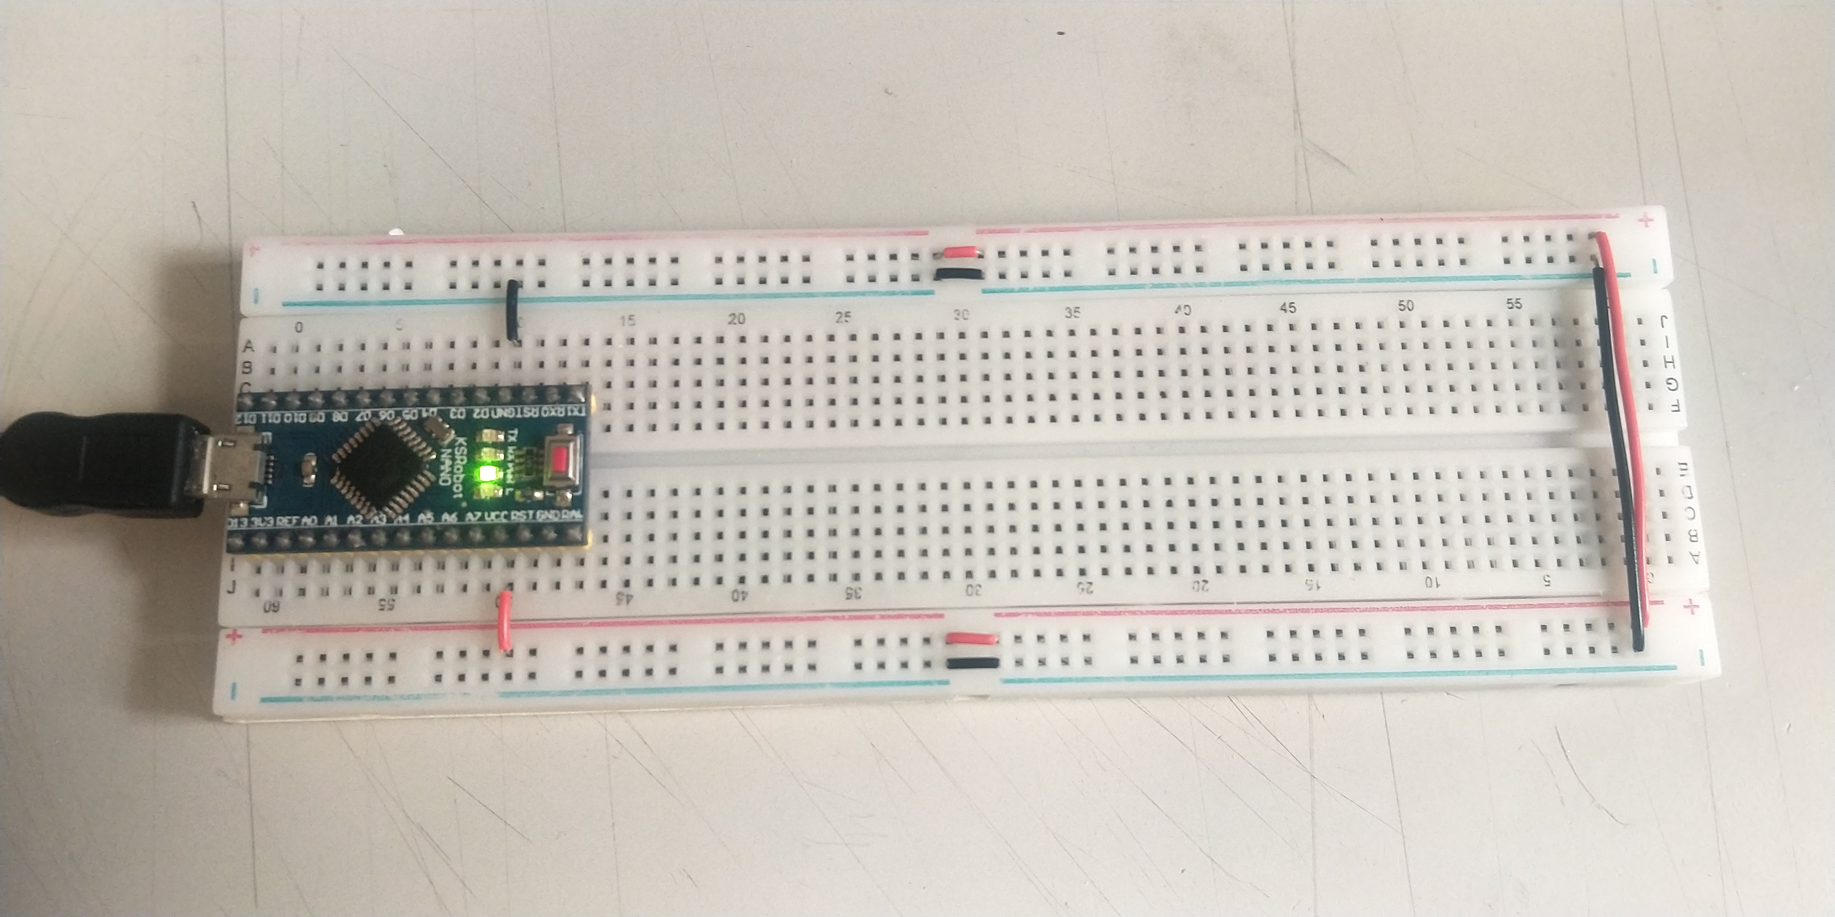
Plug Arduino NANO onto Bread Board
Connect Vcc and GND to the power line of the breadboard.
And make sure they are well connected.
USB Cable to the PC or Laptop
Notes:
VCC：C=circuit ； VDD：D=device ； VSS：S=series ; GND：在電路里常被定為電壓參考基點。 VEE：負電壓供電；場效電晶體的源極（S） VPP：程式設計/擦除電壓。 https://codertw.com/%E7%A8%8B%E5%BC%8F%E8%AA%9E%E8%A8%80/423512/
Then, we supply the power to the breadboard with the Vcc and GND pin on the Arduino NANO board by connecting Vcc and GND of Arduino NANO to the power line of the breadboard.

Slide 7
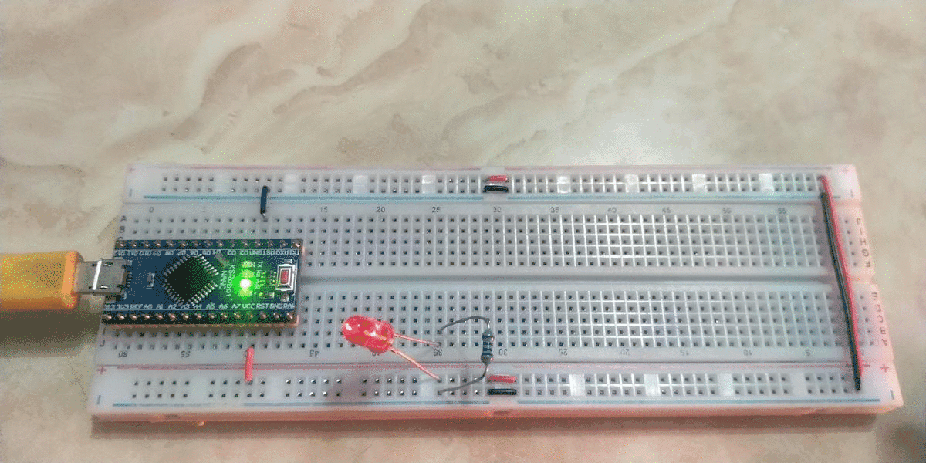
Test the Power Line of the Bread Board
We can use a pair of LED and resistor to test the power line.
Long LED pin to +5V, short LED pin connect to one of the resistor pin.
The other pin of the resistor connect to the GND.
Do not omit the resistor and connect the LED directly to power.
Notes:
Then, we can use a pair of LED and resistor to test the power line to see if the originally isolated buses are well connected.
Long LED pin to +5V, short LED pin connect to one of the resistor pin.
The other pin of the resistor connect to the GND.
Please notice that do not omit the resistor and connect the LED directly to power.

Slide 8
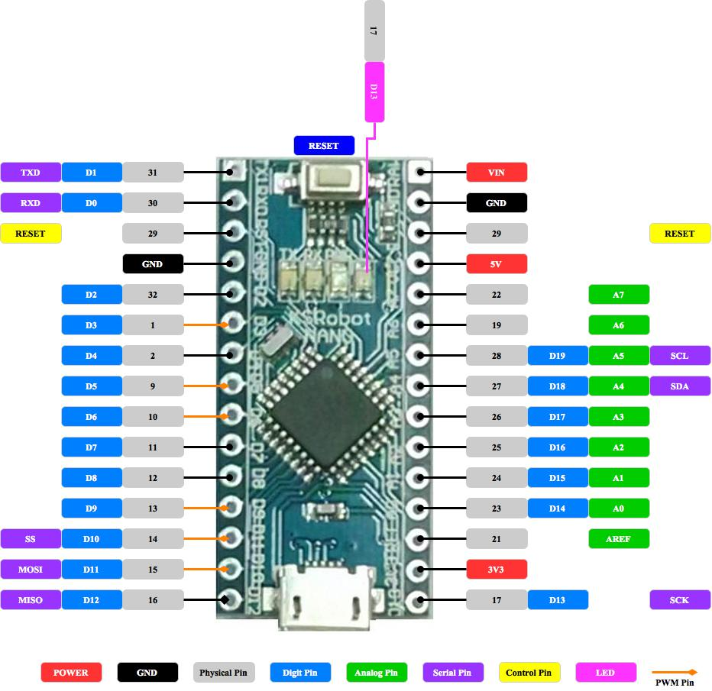
Arduino NANO Pinout
In Arduino NANO,
We have 20 digital pins (D0 ~ D19) and
8 analog pins (A0 ~ A7)
Let’s first talk about these GPIO pins.
Notes:
In Arduino NANO, we have 20 digital pins (D0 ~ D19) and 8 analog pins (A0 ~ A7)
Let’s first talk about these GPIO pins.

Slide 9
GPIO pins of Arduino
Introduction
General-Purpose Input Output (GPIO) is a digital pin of an IC.
It can be used as input or output for interfacing devices.
If we want to read switch’s state, sensor data, etc. then we need to configure it as input.
If we want to control the LED brightness, motor rotation, show text on display, etc. then we need to configure it as output.
Arduino GPIO
Arduino digital pins can be configured as input/output to read digital signals or to drive output devices.
Arduino analog pins can also be configured as input/output to read analog values or generate analog signals.
Arduino analog pins can also be used as digital input/output pins.
To configure GPIO pins, pinMode () function is used which set direction of pin as input or output.
Notes:
General-Purpose Input Output (GPIO) is a digital pin of an IC.
It can be used as input or output for interfacing devices.
If we want to read switch’s state, sensor data, etc. then we need to configure it as input.
If we want to control the LED brightness, motor rotation, show text on display, etc. then we need to configure it as output.
Arduino digital pins can be configured as input/output to read digital signals or to drive output devices.
Arduino analog pins can also be configured as input/output to read analog values or generate analog signals.
Arduino analog pins can also be used as digital input/output pins.
To configure GPIO pins, pinMode () function is used which set direction of pin as input or output.

Slide 10
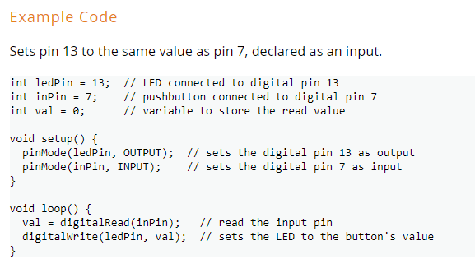
GPIO as digital input/output
Assign GPIO pin
Initialize pin value
Configure pin mode
https://www.arduino.cc/reference/en/language/functions/digital-io/digitalread/
https://www.electronicwings.com/arduino/digital-gpio-of-arduino
Notes:
Here is an example for testing Arduino GPIO pins as digital input/output.
You need to Assign GPIO pin, Initialize pin value, and configure pin mode.
Please check the link at the bottom https://www.arduino.cc/reference/en/language/functions/digital-io/digitalread/ for the details.

Slide 11
Digital Input
To read data from sensor or from any device/circuit, we need to configure digital pin as input. Arduino pin are set as digital input (default). So, there is no need to configure pin as input.
To configure pin as digital input, pinMode () function is used.
We can read data from GPIO pin using digitalRead() function: digitalRead(pin)
It is used to read data from specified GPIO pin.
https://www.electronicwings.com/arduino/digital-gpio-of-arduino
Notes:
To read data from senor or from any device/circuit, we need to configure digital pin as input. Arduino pin are set as digital input (default). So, there is no need to configure pin as input.
To configure pin as digital input, pinMode () function is used.
We can read data from GPIO pin using digitalRead() function.
digitalRead(pin) is used to read data from specified GPIO pin.

Slide 12
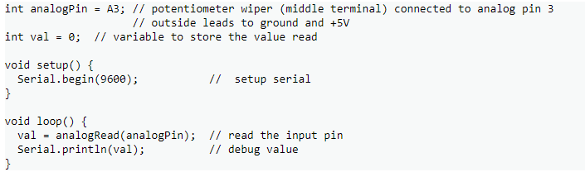
Analog Input
analogRead()
Description
Reads the value from the specified analog pin. Arduino boards contain a multichannel, 10-bit analog to digital converter. This means that it will map input voltages between 0 and the operating voltage(5V or 3.3V) into integer values between 0 and 1023. On an Arduino UNO, for example, this yields a resolution between readings of: 5 volts / 1024 units or, 0.0049 volts (4.9 mV) per unit. Please check the reference link for the usable pins, operating voltage and maximum resolution for selected Arduino boards.
Assign GPIO pin
Initialize pin value
Read pin value
https://www.arduino.cc/reference/en/language/functions/analog-io/analogread/
Notes:
analogRead() function can be used to Read the value from the specified analog pin. Arduino boards contain a multichannel, 10-bit analog to digital converter. This means that it will map input voltages between 0 and the operating voltage(5V or 3.3V) into integer values between 0 and 1023. On an Arduino NANO, for example, this yields a resolution between readings of: 5 volts / 1024 units or, 0.0049 volts (4.9 mV) per unit. Please check the reference link for the usable pins, operating voltage and maximum resolution for selected Arduino boards.

Slide 13
pinMode(pin no, Mode)
This function is used to configure GPIO pin as input or output.
pin no: number of pin whose mode we want to set
Mode INPUT, OUTPUT or INPUT_PULLUP
E.g. pinMode (3, OUTPUT) //set pin 3 as output
These Arduino pins can source or sink current up to 40 mA which is sufficient to drive led, LCD display but not sufficient for motors, relays, etc.
Note: Short circuits on Arduino pins, or attempting to run high current devices from them, can damage or destroy the output transistors in the pin, or damage the entire chip. If this happen frequently, it will result in a "dead" pin in the microcontroller but the remaining chip will still function adequately. For this reason, it is a good idea to connect OUTPUT pins to other devices with 470Ω or 1k resistors, unless maximum current draw from the pins is required for a particular application.
These pin produce output in terms of HIGH (5 V or 3.3 V) or LOW (0 V). We can set output on these pins using digitalWrite (pin no, value) function
This function is used to set output as HIGH (5 V) or LOW (0 V)
pin no: number of a pin whose value we want to set
Output value HIGH or LOW. E.g. digitalWrite (3, HIGH)
Notes:
pinMode() function is used to configure GPIO pin as input or output.
pin number is the number of pin whose mode we want to set.
3 Modes are available to configure the pins, they are INPUT, OUTPUT or INPUT_PULLUP.
for example, pinMode (3, OUTPUT) is to set pin 3 as output.
These Arduino pins can source or sink current up to 40 mA which is sufficient to drive LED or LCD display but not sufficient for motors, relays, etc.
Please note that Short circuits on Arduino pins, or attempting to run high current devices from them can damage or destroy the output transistors in the pin, or damage the entire chip. If this happen frequently, it will result in a "dead" pin in the microcontroller but the remaining chip will still function adequately. For this reason, it is a good idea to connect OUTPUT pins to other devices with 470Ω or 1k resistors, unless maximum current draw from the pins is required for a particular application.
These pins produce output in terms of HIGH (5 V or 3.3 V) or LOW (0 V). We can set output on these pins using digital Write () function.
This function is used to set output as HIGH (5 V) or LOW (0 V).
pin number: number of a pin whose value we want to set.
for example, digital Write (3, HIGH).

Slide 14
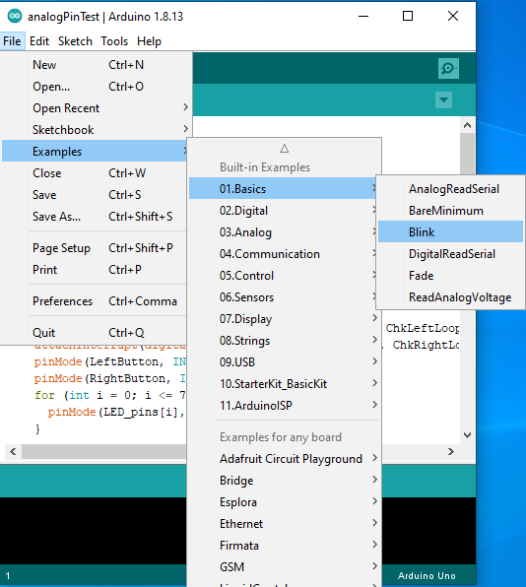
Built-in Example code
There are many useful example codes built into the Arduino IDE.
We strongly recommend that you can take a look first.
Basics -> Blink : Initialize GPIO pins and blink LED
Digital -> Button : Read digital signal with “polling”
Analog -> Analog input : Read analog signal
With the above example, we can learn :
How to light up the led
How to read button state with polling
How to read voltage from VR
But, polling is not really a good idea
Let’s try an advanced approach -- interrupt
Notes:
There are many useful example codes built into the Arduino IDE.
We strongly recommend that you can take a look first.
Basics -> Blink : Initialize GPIO pins and blink LED.
Digital -> Button : Read digital signal with “polling”.
Analog -> Analog input : Read analog signal.
With the above example, we can learn :
How to light up the led.
How to read button state with polling.
How to read voltage from VR.
But, polling is not really a good idea.
Let’s try an advanced approach – interrupt.

Slide 15
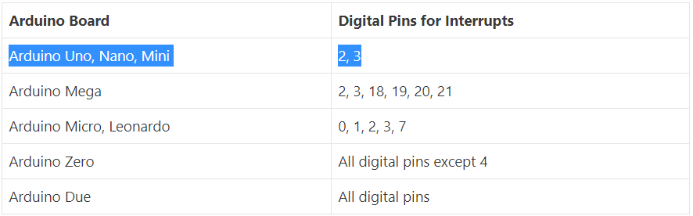
Arduino Interrupts Pins
In this Lab we’ll be using an Arduino Nano board, so we only have two choices!
We can either use pin 2 or pin 3 for button activity detection.
https://roboticsbackend.com/arduino-interrupts/
Notes:
In this Lab we’ll be using an Arduino Nano board.According to this table, we only have two choices!
We can either use pin 2 or pin 3 for button activity detection.

Slide 16
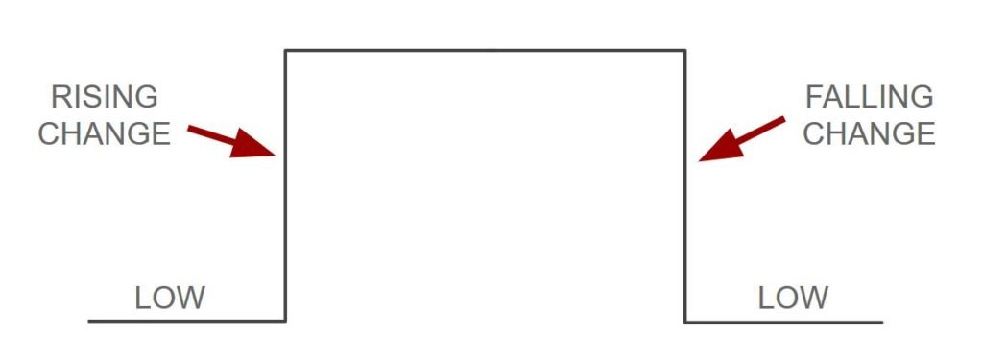
Types of Interrupts
Arduino interrupts are triggered when there is a change in the digital signal you want to monitor.
But you can choose exactly what you want to monitor. For that you’ll have to modify the 3rd parameter of the attachInterrupt() function:
RISING: Interrupt will be triggered when the signal goes from LOW to HIGH
FALLING: Interrupt will be triggered when the signal goes from HIGH to LOW
CHANGE: Interrupt will be triggered when the signal changes (LOW to HIGH or HIGH to LOW)
LOW: Interrupt will be triggered whenever the signal is LOW
https://roboticsbackend.com/arduino-interrupts/
Notes:
Arduino interrupts are triggered when there is a change in the digital signal you want to monitor.
But you can choose exactly what you want to monitor. For that you’ll have to modify the 3rd parameter of the attachInterrupt() function:
If we monitor voltage RISING, then Interrupt will be triggered when the signal goes from LOW to HIGH
If we monitor voltage FALLING, then Interrupt will be triggered when the signal goes from HIGH to LOW
If we monitor voltage CHANGE, then Interrupt will be triggered when the signal changes (LOW to HIGH or HIGH to LOW)
If we monitor voltage LOW, then Interrupt will be triggered whenever the signal is LOW

Slide 17
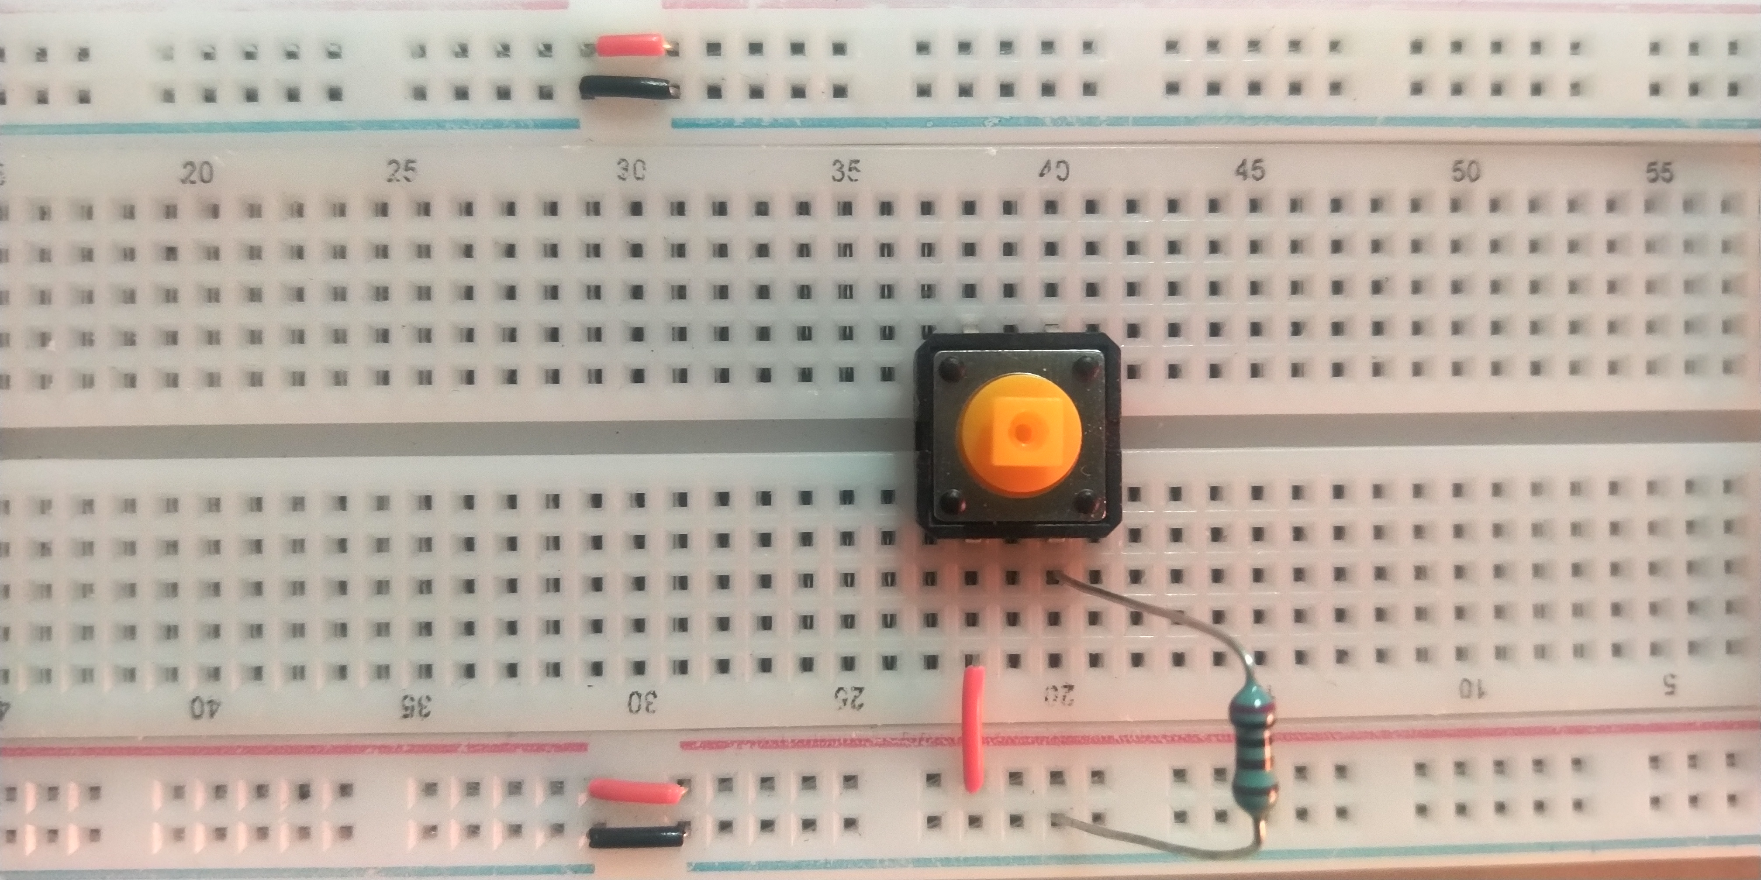
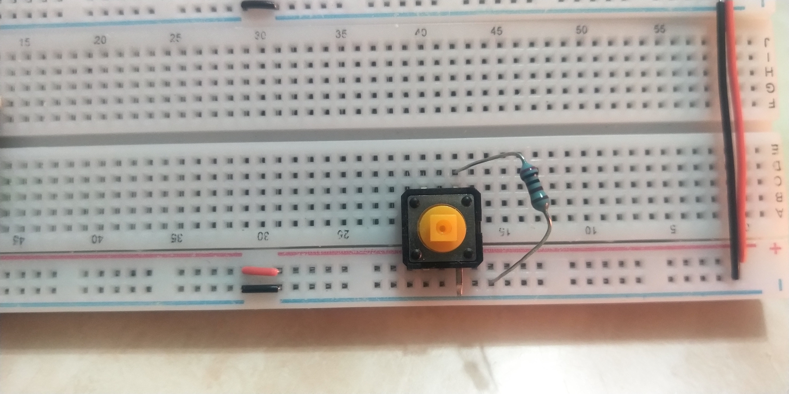
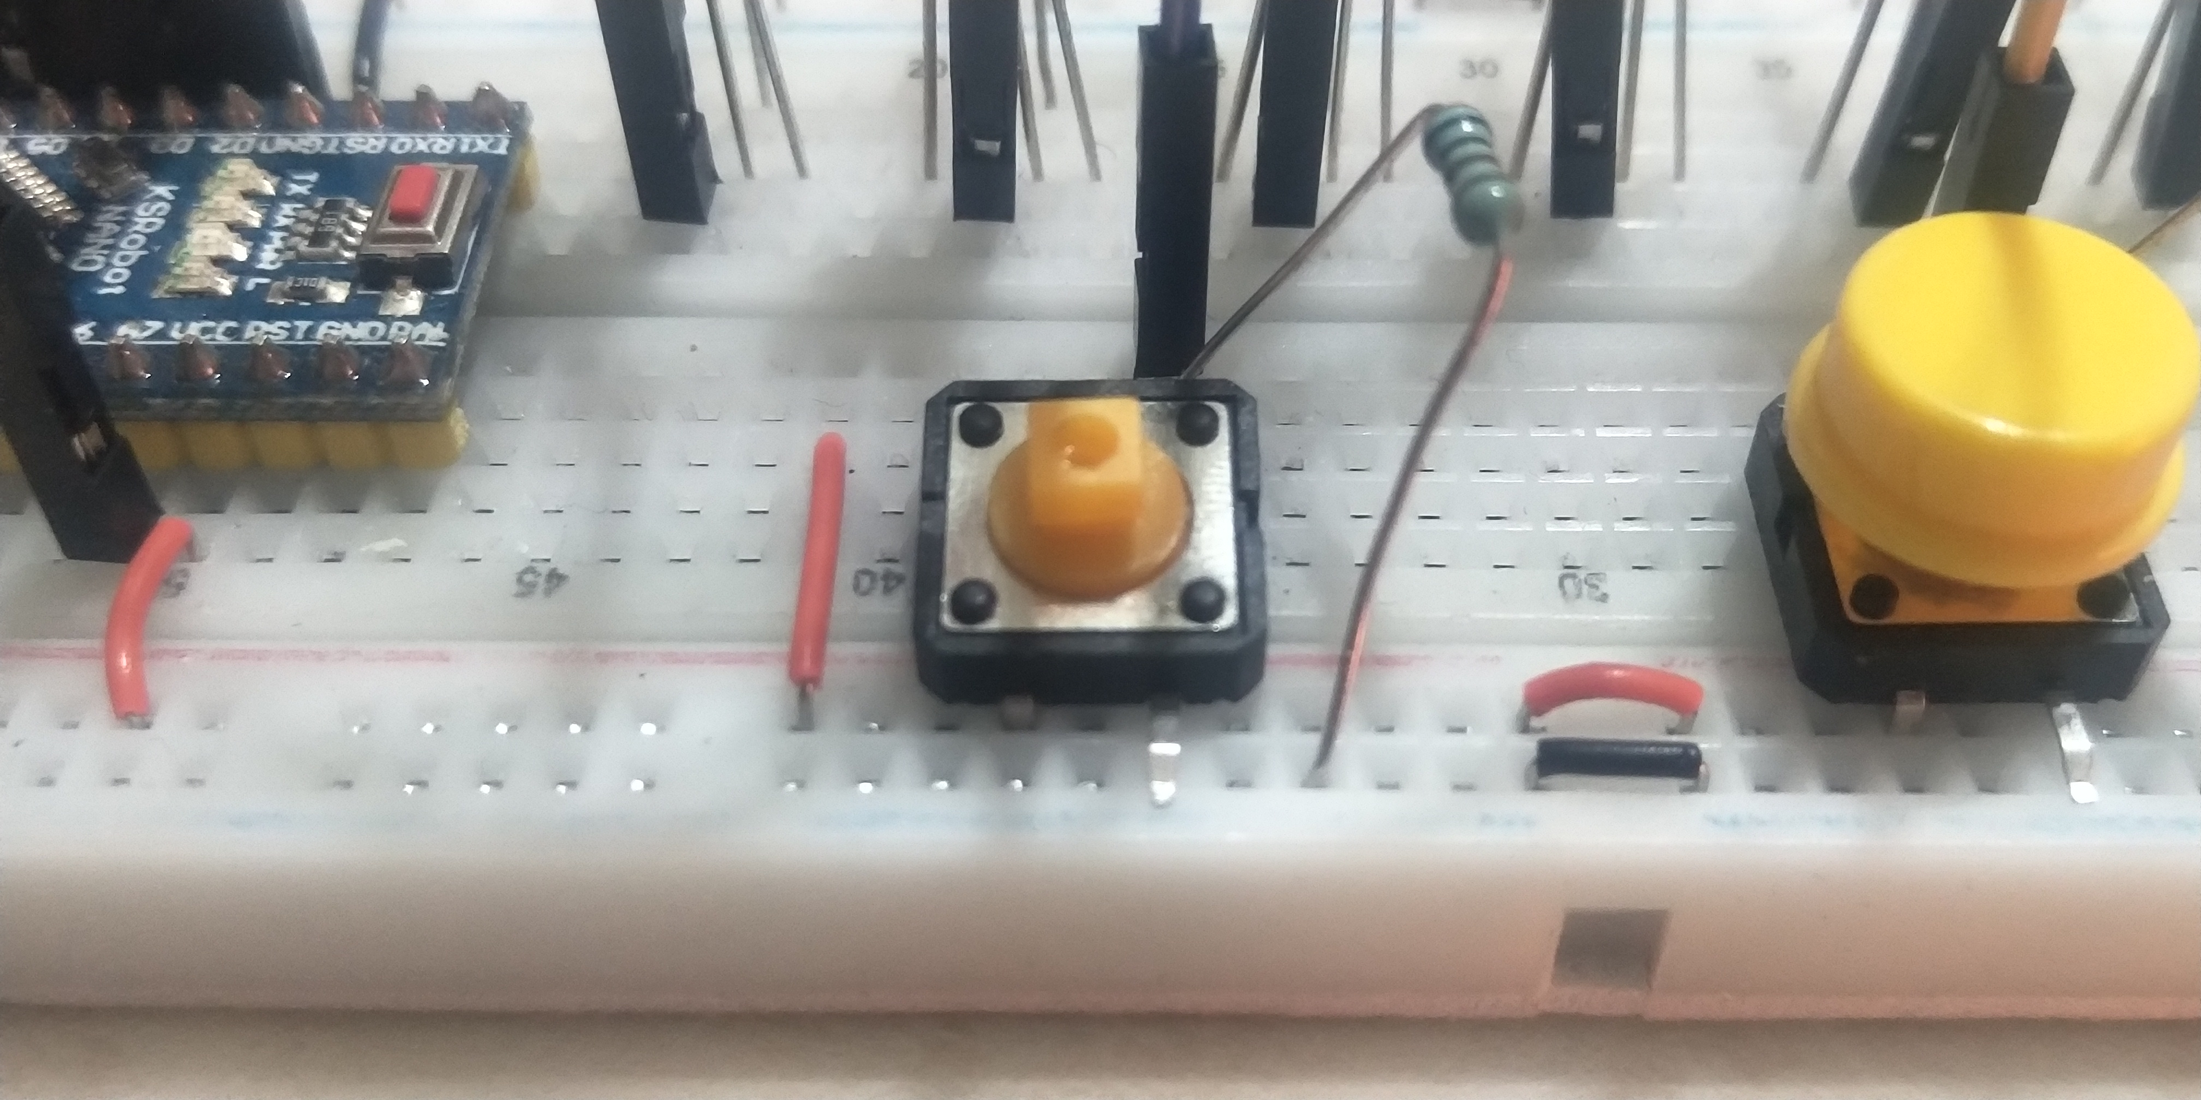
Placement of the button switch on the breadboard
Normally, we can place the button switch across the center line of the breadboard
Pin A connected to Vcc and make level of pin A,D HIGH (+5V)
Pin B connected to GND through an 1K resistor
and make level of pin B,C LOW
Pin C connected to predefined GPIO pin,
Normally, the level of pin C is LOW
When button is pressed, pin A,B and pin C,D will touch together
and the level of pin C,D will pull up to HIGH
D
C
A
B
If you don’t have much place on the breadboard, you are allowed to bend pin B and leave it outside
D
C
A
B
Notes:
This figure shows the Placement of the button switch on the breadboard.
Normally, we can place the button switch across the center line of the breadboard.
Pin A connected to Vcc and make level of pin A,D HIGH (+5V).
Pin B connected to GND through an 1K resistor
and make level of pin B,C LOW.
Pin C connected to predefined GPIO pin,
Normally, the level of pin C is LOW.
When button is pressed, pin A,B and pin C,D will touch together
and the level of pin C,D will pull up to HIGH.
If you don’t have much place on the breadboard, you are allowed to bend pin B and leave it outside.

Slide 18
Do it yourself
Requirement
Finish the IDE installation and environment setup
Digital output with GPIO:
Blink LED as assigned or your creative pattern.
Digital input with GPIO:
Push button switch to change LED blinking pattern
Analog input with GPIO:
Turn VR to change LED blinking speed
Report
Your report should include the code
Submit your report with the file name StudentID_Lab_1.docx to eLearn
Due:
Notes:
Now it's your turn to do it.
the Requirement is to
Finish the IDE installation and environment setup.
Digital output with GPIO,
Blink LED as assigned or your creative pattern.
Digital input with GPIO,
Push button switch to change LED blinking pattern.
Analog input with GPIO,
Turn VR to change LED blinking speed.
You also need to submit a Report after class,
The code should be included in The report.
The report should be Submitted with the file name StudentID_Lab_1.docx to ilms before the deadline.

Slide 19
Appendix

Slide 20
USB driver for Arduino Nano
The Driver
First of all, we need a Driver. A Chinese company develop a driver here http://www.wch.cn/downloads.php
It is a little bit painful to find it on the web site. So here is a copy: CH341SER_MAC
Install the Driver
• unzip the downloaded file
• run the installer
if restart needed skip this step, we are going to restart later

Slide 21
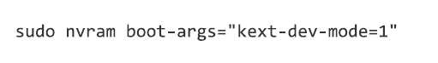
USB driver for Arduino Nano
• If you use Yosemite
Open Terminal Application
use the following command line _ know more about that
Reboot your mac
• If you use El Capitan
Reboot and press CMD+R (hold both keys) immediately after the chime to Enter Recovey Mode
Open Terminal from Recovery mode
run the command
reboot

Slide 22
How to make it work
• Use it on Arduino IDE
After restarting your mac, you can start Arduino with your Arduino plugged to the USB. you should be able to see a new Serial deviced named
/dev/cu.wchusbserialXXXXXXXX
Sources
http://kiguino.moos.io/2014/12/31/how-to-use-arduino-nano-mini-pro-with-CH340G-on-mac-osx-yosemite.html
https://cindori.org/trim-enabler-and-yosemite/

Slide 23
How to make it work
• Use it on Arduino IDE
After restarting your mac, you can start Arduino with your Arduino plugged to the USB. you should be able to see a new Serial deviced named
/dev/cu.wchusbserialXXXXXXXX
Sources
http://kiguino.moos.io/2014/12/31/how-to-use-arduino-nano-mini-pro-with-CH340G-on-mac-osx-yosemite.html
https://cindori.org/trim-enabler-and-yosemite/

Slide 24
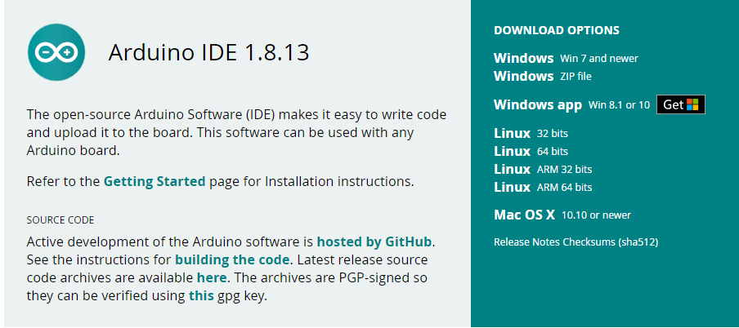
Download and install Arduino IDE
You can find your suitable version of Arduino driver and IDE at the link below:
Ver. 1.8.13 is tested for examples and suggested
https://www.arduino.cc/en/software
https://www.arduino.cc/en/software

Slide 25
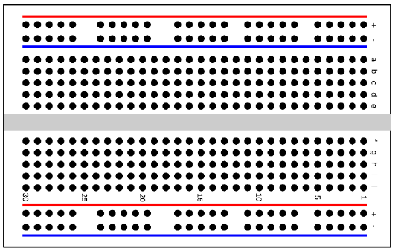
Breadboard
What is a breadboard?
Breadboard is an important board in electronics to do prototyping.
These boards are solderless since you do not have to solder them. Electronic prototyping and circuit making has different options. Other notable ones are PCB (Printed Circuit Board) which is usually printed on the board. Once it has been done, you cannot change that. That is why breadboards are so useful.
https://www.slideshare.net/MahadiHasan39/what-is-a-breadboard-79408498?from_action=save

Slide 26
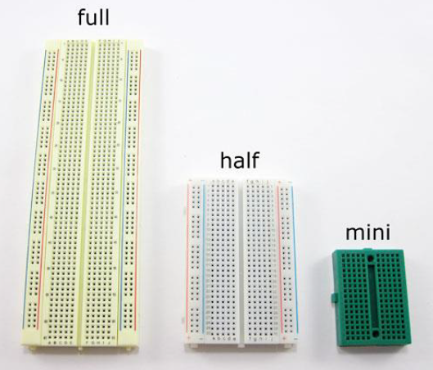
The connections are not permanent, so it is easy to remove a component if you make a mistake, or just start over and do a new project. This makes breadboards great for beginners who are new to electronics. You can use breadboards to make all sorts of fun electronics projects, from different types of robots or an electronic drum set, to an electronic rain detector to help conserve water in a garden, just to name a few. Their sizes vary per the number of pins they have.
https://www.slideshare.net/MahadiHasan39/what-is-a-breadboard-79408498?from_action=save

Slide 27
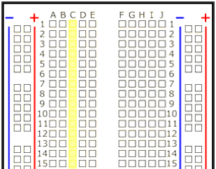
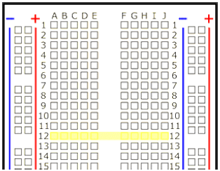
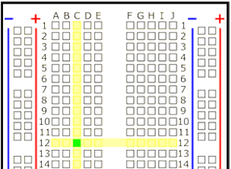
Breadboard labels: rows, columns, and buses
What do the letters and numbers on a breadboard mean?
Most breadboards have some numbers, letters, and plus and minus signs written on them. What does all that mean? While their exact appearance might vary from breadboard to breadboard, the general purpose is always the same. These labels help you locate certain holes on the breadboard so you can follow directions when building a circuit. If you have ever used a spreadsheet program like Microsoft Excel® or Google Sheets™, the concept is exactly the same. Row numbers and column letters help you identify individual holes in the breadboard, just like cells in a spreadsheet. For example :
All of the highlighted holes are in "column C."
All of the highlighted holes are in "row 12."
"Hole C12" is where column C intersects row 12.

Slide 28
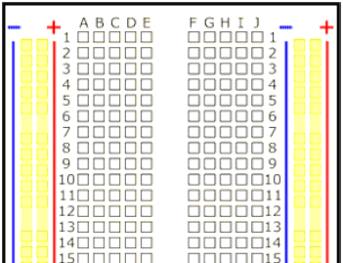
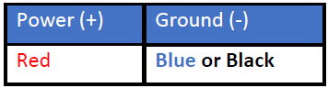
What do the colored lines and plus and minus signs mean?
What about the long strips on the side of the breadboard, highlighted in yellow here?
These strips are typically marked by red and blue (or red and black) lines, with plus (+) and minus (-) signs, respectively. They are called the buses, also referred to as rails, and are typically used to supply electrical power to your circuit when you connect them to a battery pack or other external power supply. The table below tells the usual color code for the Power and Ground sources.
Note that there is no physical difference between the positive and negative buses, and using them is not a requirement. The labels just make it easier to organize your circuit, similar to color-coding your wires. It is a good practice to colour code your circuits as it is easier to distinguish them later on.

Slide 29
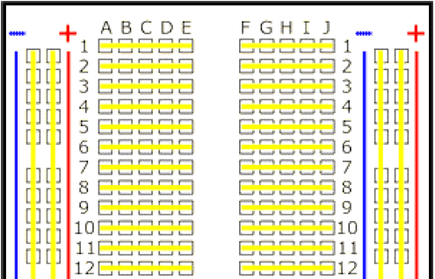
How are the holes connected?
Buses on opposite sides of the breadboard are not connected to each other. Typically, to make power and ground available on both sides of the breadboard, you would connect the buses with jumper wires, like this. Make sure to connect positive to positive and negative to negative (see the section on buses if you need a reminder about which color is which).

Slide 30
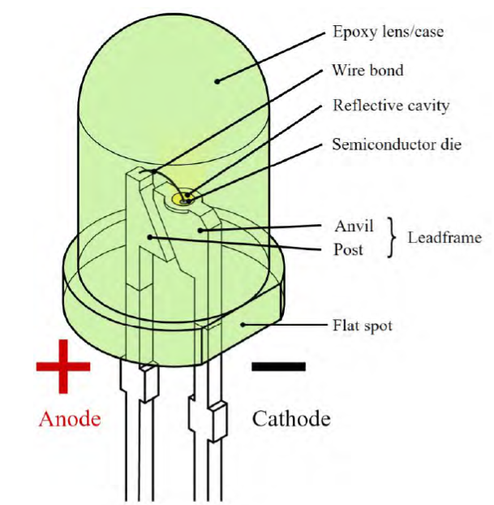
How to differentiate polarities of a LED
LED(Light-emitting diode)
Long Pin is Positive(Connected to VCC)
Short Pin is Negative(Connected to GND)
specification&characteristic of a LED
GND
VCC
https://zh.wikipedia.org/wiki/發光二極管

Slide 31
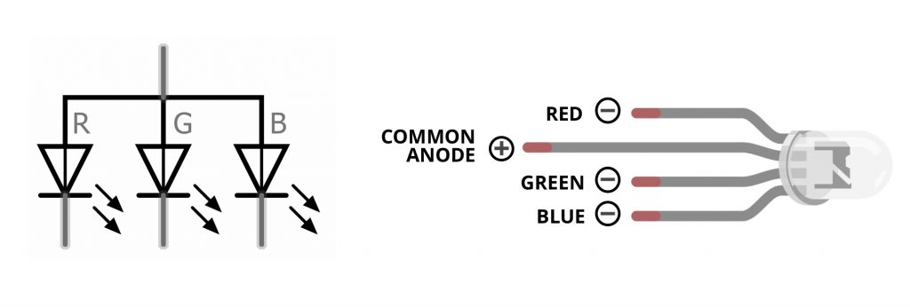
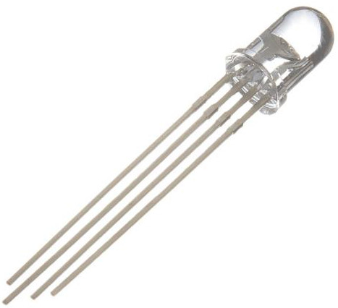
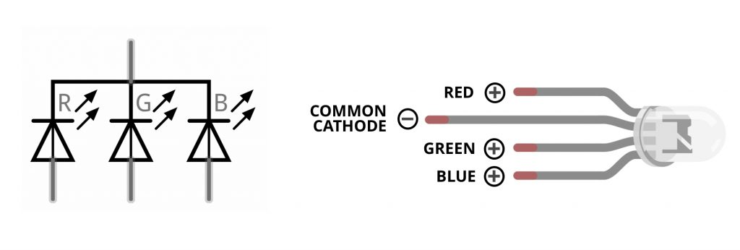
RGB LEDs
https://forum.chumbaka.asia/blog/2018/04/23/learn-difference-between-a-common-anode-and-common-cathode-tri-colour-led/

Slide 32
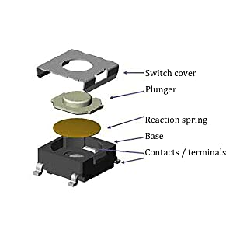
Buttons Schematics
Notice that the pairs of pins
A-D and B-C are always connected
Please pay attention when wiring
do not make short circuit
D
A
C
B

Slide 33
Button as a GPIO input
There are 2 mechanisms implementing switch
Step 1
(A)Resistor pull low
(logic of the GPIO pin will be LOW)
(B)Resistor pull high
(logic of the GPIO pin will be LOW)
Vcc
Any GPIO pin
Any GPIO pin
GND

Slide 34
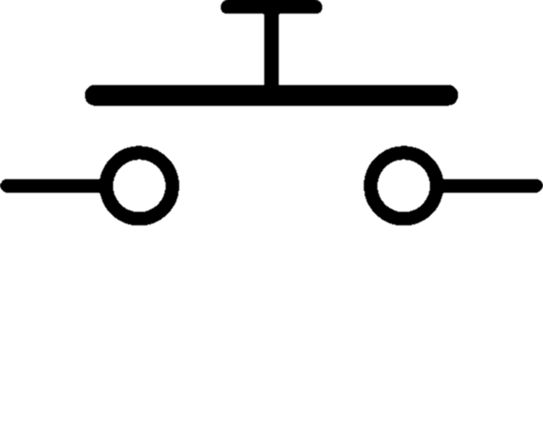
Button as a GPIO input(Cont’d)
There are 2 mechanisms implementing switch
Step 2 Interpolate the button sw
(A)between GPIO pin and 3.3V
(logic of the GPIO pin will be LOW)
(B)between GPIO pin and GND
(logic of the GPIO pin will be HIGH)
Vcc
Vcc
LOW
HIGH
GND
GND

Slide 35
Button as a GPIO input (Cont’d)
There are 2 mechanisms implementing switch
Step 3 press the button
(A)GPIO PIN will be pulled HIGH by the SW
(logic of the GPIO pin will be HIGH)
(B) GPIO PIN will be pulled HIGH by the SW
(logic of the GPIO pin will be LOW)
Vcc
Vcc
HIGH
LOW
GND
GND

Slide 36
Placement of the button switch on the breadboard
Normally, we can place the button switch across the center line of the breadboard
Pin A connected to Vcc and make level of pin A,D HIGH (+5V)
Pin B connected to GND through an 1K resistor
and make level of pin B,C LOW
Pin C connected to predefined GPIO pin,
Normally, the level of pin C is LOW
When button is pressed, pin A,B and pin C,D will touch together
and the level of pin C,D will pull up to HIGH
D
C
A
B
But, if you don’t have much place on the breadboard, you are allowed to bend pin B and leave it outside
D
C
A
B

Slide 37
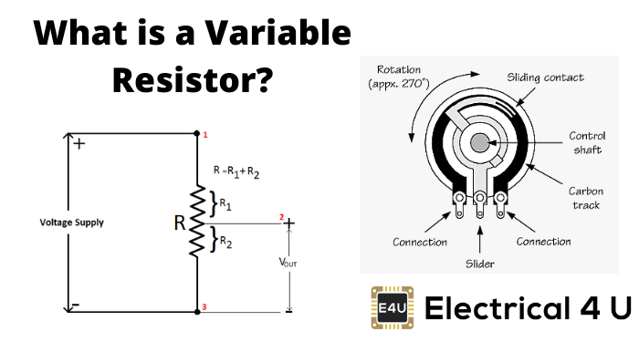
What is a Variable Resistor
A variable resistor is a type of resistor whose electrical resistance value can be adjusted on demand.
https://www.electrical4u.com/variable-resistors/

Slide 38
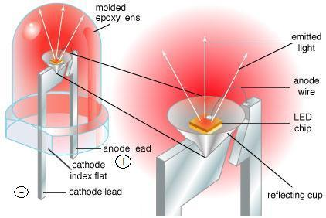
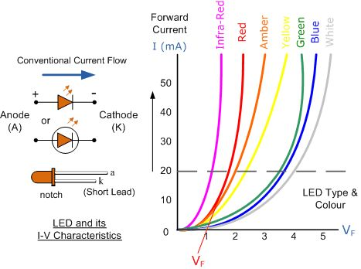
Why do we need a resistor when connect to an LED
https://www.dnatechindia.com/Tutorial/Diode/Light-Emitting-Diodes.html

